Slide 1

Term Paper presentation
Erivelton Gualter dos Santos
Nonlinear System
Ri, S., Huang, J., Wang, Y., Kim, M., & An, S. (2014). Terminal sliding mode control of mobile wheeled inverted pendulum system with nonlinear disturbance observer. Mathematical Problems in Engineering, 2014.

Slide 2
Introduction
Terminal Sliding Mode Control with Disturbance Observer

Slide 3
Introduction
MWIP stands for Mobile Wheeled Inverted Pendulum;
MWIP can be used for delivery and touring;
Examples of MWIP:
Segway (www.segway.com/);
JOE (Swiss Federal Institute of Technology Lausanne);
UW-Car
PMP (Faculty of Engineering, Tamagawa University).

Slide 4
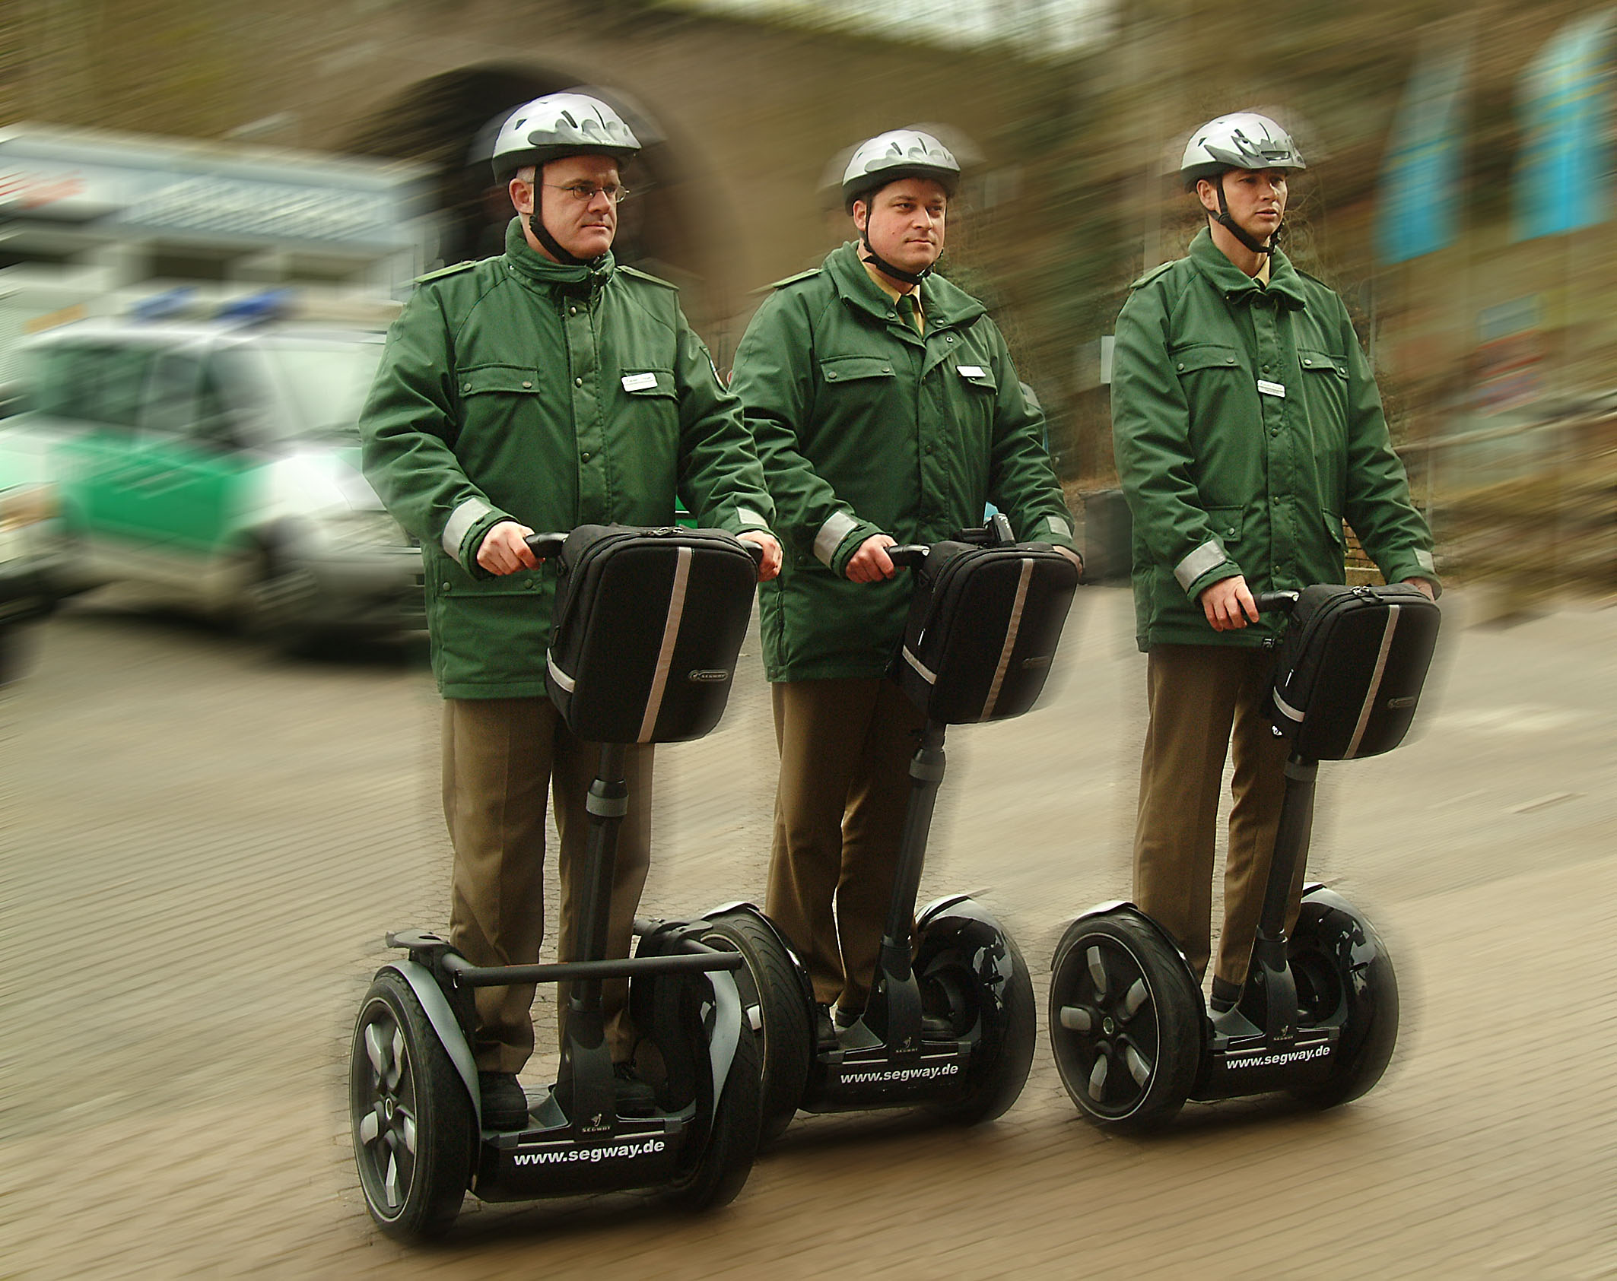
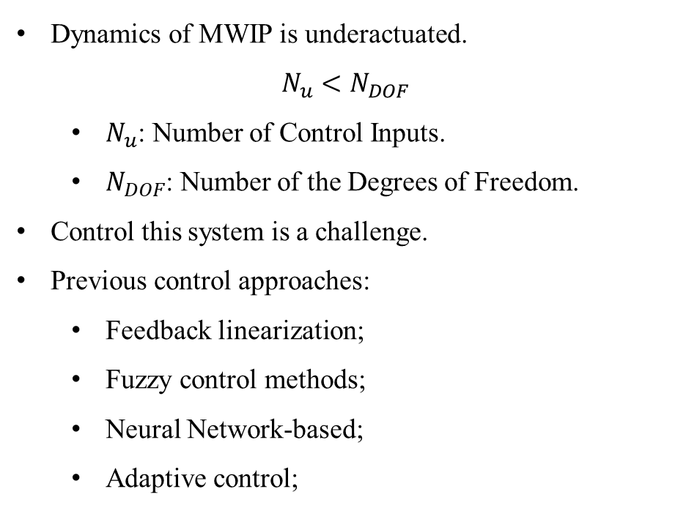
MWIP System
Dynamics of MWIP is underactuated. $N_{u}<N_{DOF}$
$N_{u}$: Number of Control Inputs.
$N_{DOF}$: Number of the Degrees of Freedom.
Control this system is a challenge.
Previous control approaches:
Feedback linearization;
Fuzzy control methods;
Neural Network-based;
Adaptive control;
This Photo by Unknown Author is licensed under CC BY-SA

Slide 5
System Formulation
Terminal Sliding Mode Control with Disturbance Observer

Slide 6
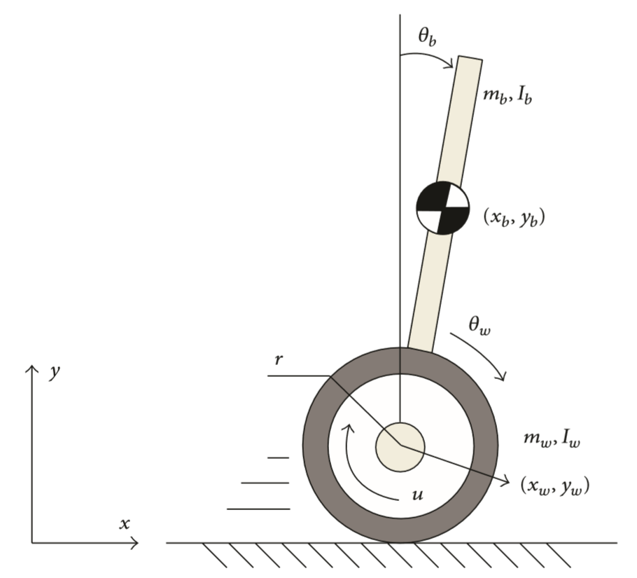
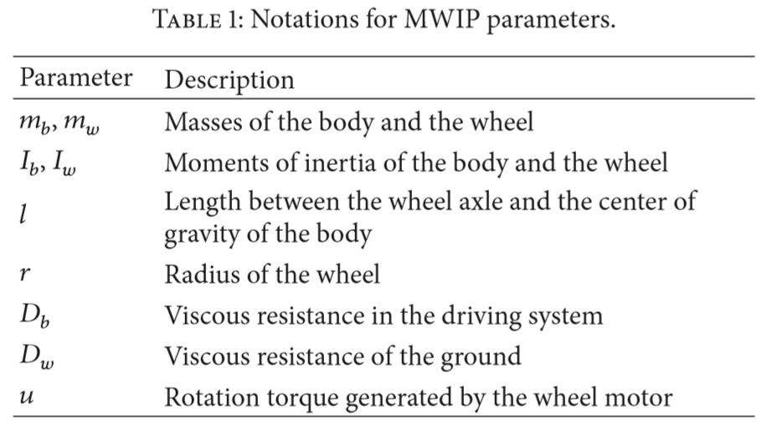
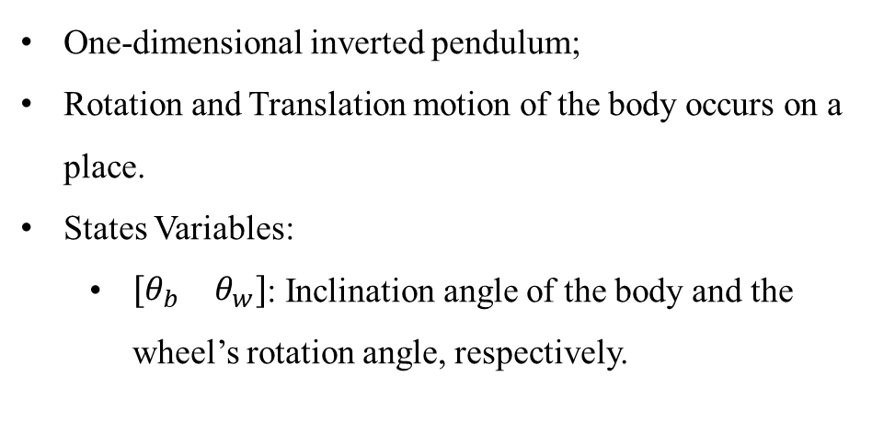
System Formulation
One-dimensional inverted pendulum;
Rotation and Translation motion of the body occurs on a place.
States Variables:
$\left[\begin{matrix}θ_{b} & θ_{w}\end{matrix}\right]$: Inclination angle of the body and the wheel’s rotation angle, respectively.
Mobile wheeled inverted pendulum (MWIP) system model.

Slide 7
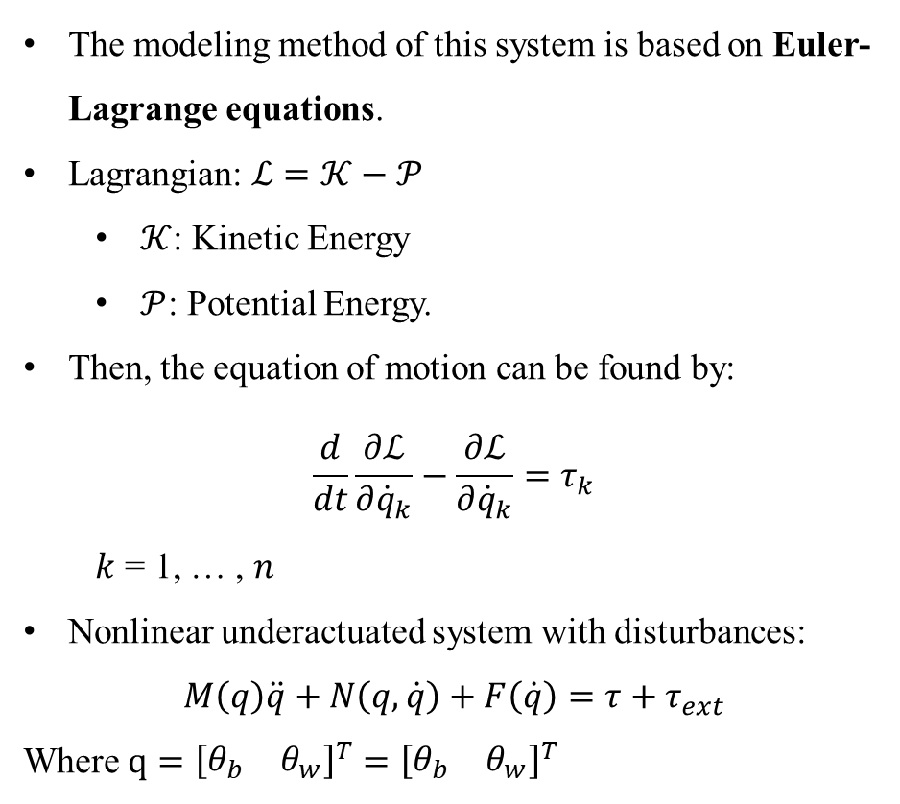
Modeling
The modeling method of this system is based on Euler-Lagrange equations.
Lagrangian: $ℒ=𝒦−𝒫$
$𝒦$: Kinetic Energy
$𝒫$: Potential Energy.
Then, the equation of motion can be found by:
$$\frac{d}{dt}\frac{∂ℒ}{∂{\dot{q}}_{k}}−\frac{∂ℒ}{∂{\dot{q}}_{k}}=τ_{k}$$
$k$ = 1, … , $n$
Nonlinear underactuated system with disturbances:
$$M\left(q\right)\ddot{q}+N\left(q,\dot{q}\right)+F\left(\dot{q}\right)=τ+τ_{ext}$$
Where $q={\left[\begin{matrix}θ_{b} & θ_{w}\end{matrix}\right]}^{T}={\left[\begin{matrix}θ_{b} & θ_{w}\end{matrix}\right]}^{T}$
Mobile wheeled inverted pendulum (MWIP) system model.

Slide 8
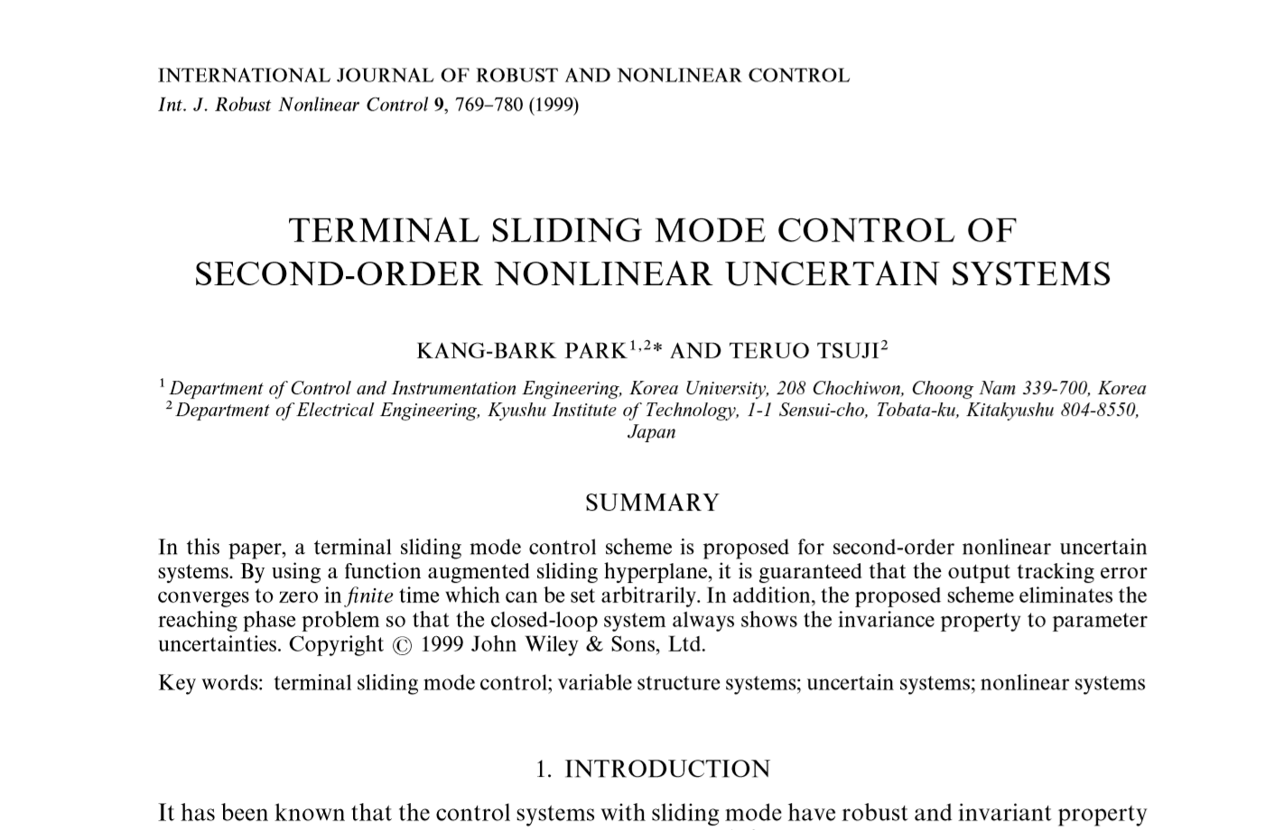
terminal sliding model controller design
Park, K. B., & Tsuji, T. (1999). Terminal sliding mode control of second‐order nonlinear uncertain systems. International Journal of Robust and Nonlinear Control: IFAC‐Affiliated Journal, 9(11), 769-780.

Slide 9
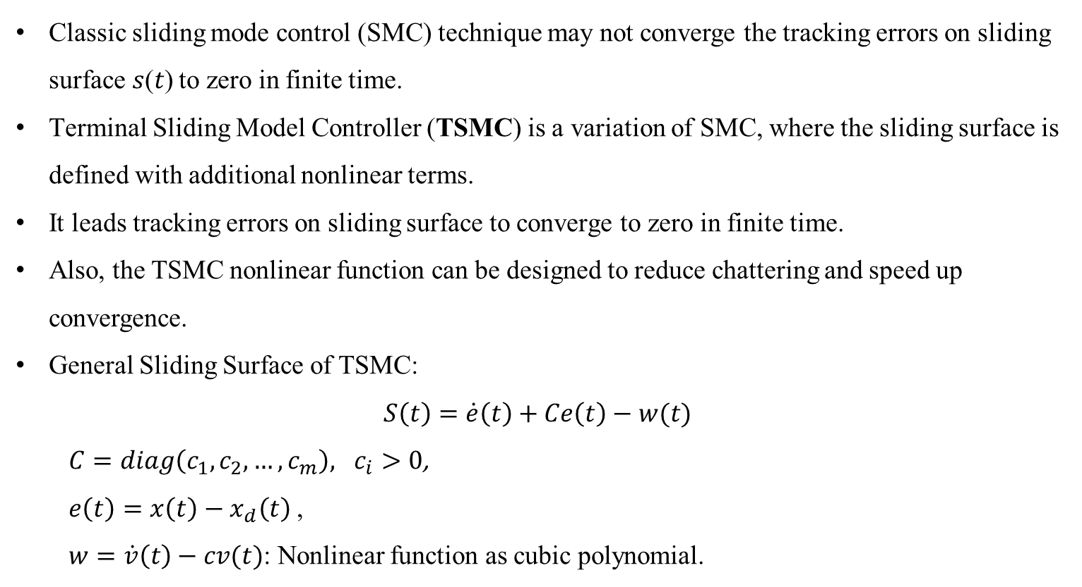
terminal sliding model controller design
Classic sliding mode control (SMC) technique may not converge the tracking errors on sliding surface 𝑠(𝑡) to zero in finite time.
Terminal Sliding Model Controller (TSMC) is a variation of SMC, where the sliding surface is defined with additional nonlinear terms.
It leads tracking errors on sliding surface to converge to zero in finite time.
Also, the TSMC nonlinear function can be designed to reduce chattering and speed up convergence.
General Sliding Surface of TSMC:
$$S\left(t\right)=\dot{e}\left(t\right)+Ce\left(t\right)−w(t)$$
$C=diag\left(c_{1},c_{2},…,c_{m}\right), c_{i}>0$,
$e\left(t\right)=x\left(t\right)−x_{d}\left(t\right)$ ,
$w=\dot{v}\left(t\right)−cv(t)$: Nonlinear function as cubic polynomial.

Slide 10
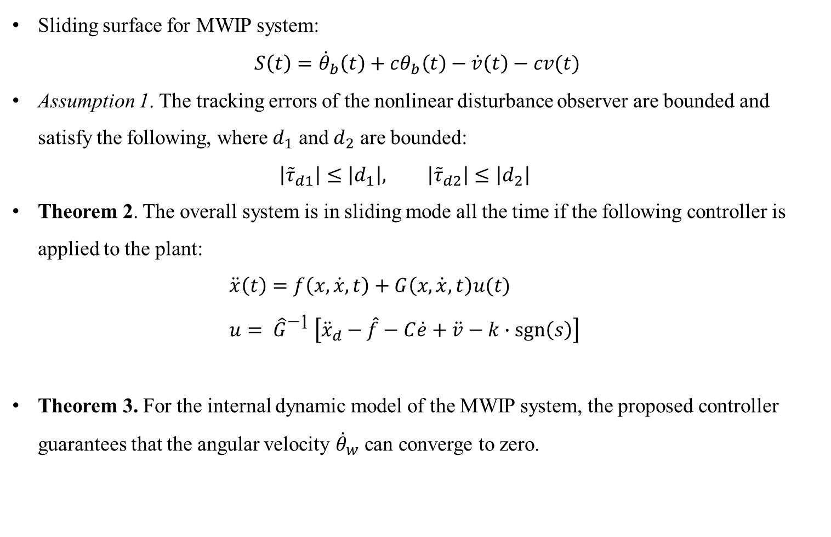
Assumptions and Theorems
Sliding surface for MWIP system: $S\left(t\right)={\dot{θ}}_{b}\left(t\right)+cθ_{b}\left(t\right)−\dot{v}\left(t\right)−cv(t)$
Assumption 1. The tracking errors of the nonlinear disturbance observer are bounded and satisfy the following, where $d_{1}$ and $d_{2}$ are bounded: $\left|{\tilde{τ}}_{d1}\right|≤\left|d_{1}\right|, \left|{\tilde{τ}}_{d2}\right|≤\left|d_{2}\right|$
Theorem 2. The overall system is in sliding mode all the time if the following controller is applied to the plant: $\ddot{x}\left(t\right)=f\left(x,\dot{x},t\right)+G\left(x,\dot{x},t\right)u(t)$ $u= {\hat{G}}^{\text{−1} }\left[{\ddot{x}}_{d}−\hat{f}−C\dot{e}+\ddot{v}−k∙\operatorname{sgn}\left(s\right)\right]$
Theorem 3. For the internal dynamic model of the MWIP system, the proposed controller guarantees that the angular velocity ${\dot{θ}}_{w}$ can converge to zero.

Slide 11
Results
Terminal Sliding Mode Control with Disturbance Observer

Slide 12
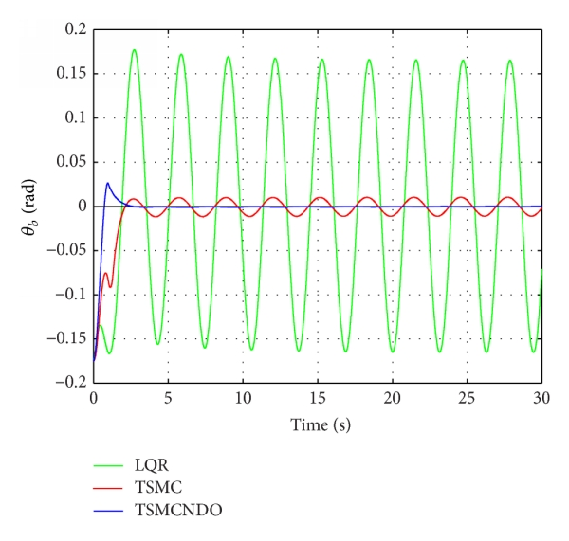
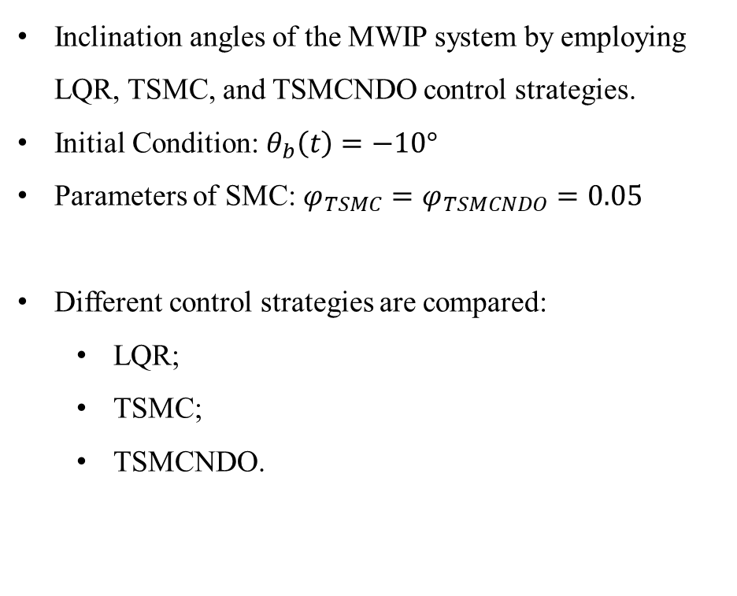
Slide Title
Output: Angle Position
Inclination angles of the MWIP system by employing LQR, TSMC, and TSMCNDO control strategies.
Initial Condition: $θ_{b}\left(t\right)=−10°$
Parameters of SMC: $φ_{TSMC}=φ_{TSMCNDO}=0.05$
Different control strategies are compared:
LQR;
TSMC;
TSMCNDO.

Slide 13
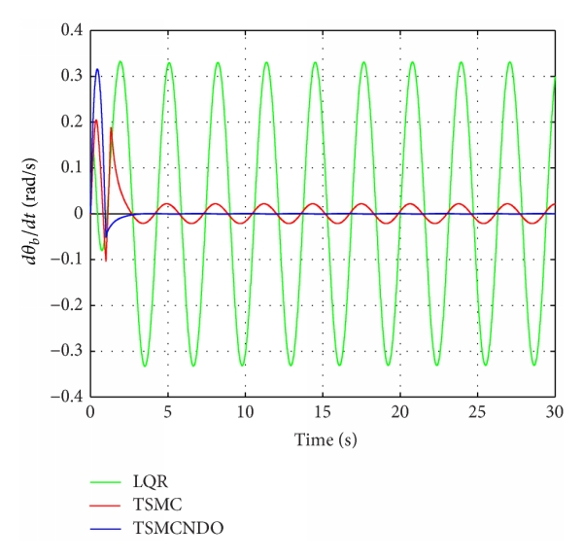
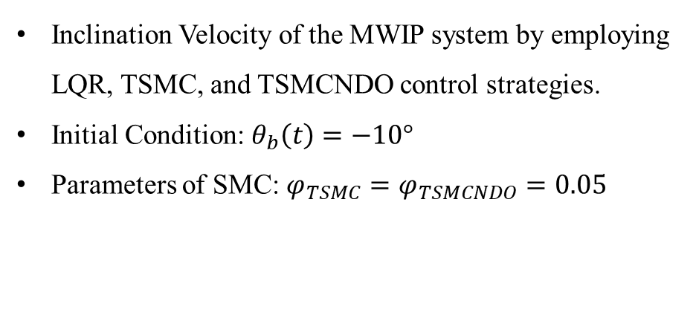
Slide Title
Output: Angular Velocity
Inclination Velocity of the MWIP system by employing LQR, TSMC, and TSMCNDO control strategies.
Initial Condition: $θ_{b}\left(t\right)=−10°$
Parameters of SMC: $φ_{TSMC}=φ_{TSMCNDO}=0.05$

Slide 14
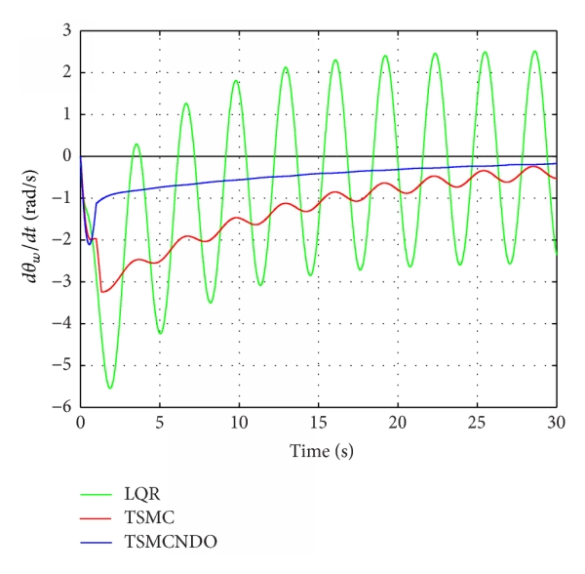
Slide Title
Wheel Rotation Velocities
Inclination Velocity of the MWIP system by employing LQR, TSMC, and TSMCNDO control strategies.
Initial Condition: $θ_{b}\left(t\right)=−10°$
Parameters of SMC: $φ_{TSMC}=φ_{TSMCNDO}=0.05$

Slide 15
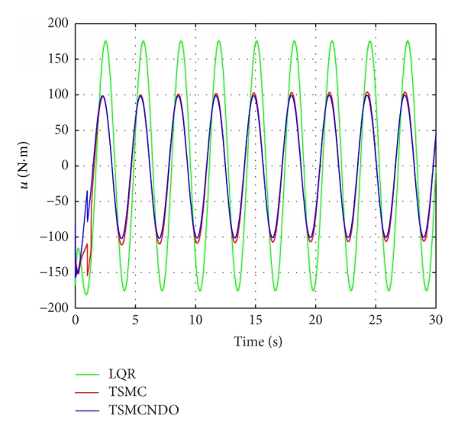
Slide Title
Control Inputs
Control inputs of the MWIP system by employing LQR, TSMC, and TSMCNDO control strategies.
“The control performance of the MWIP system by using TSMCNDO control strategy is better than the one by using TSMC control strategy”.

Slide 16
Conclusion
Terminal Sliding Mode Control with Disturbance Observer

Slide 17
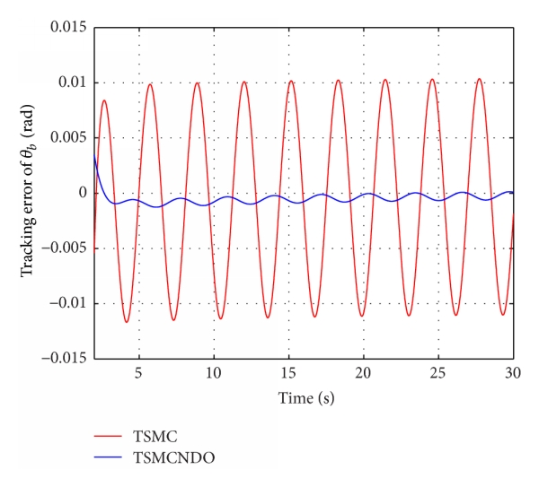
Slide Title
Conclusion
TSMC can deal with modeling uncertainties and external disturbances.
It guarantees the system trajectory converges in a finite time.
Remove chattering caused by the SMC.
Decreased Tracking error.

Slide 18
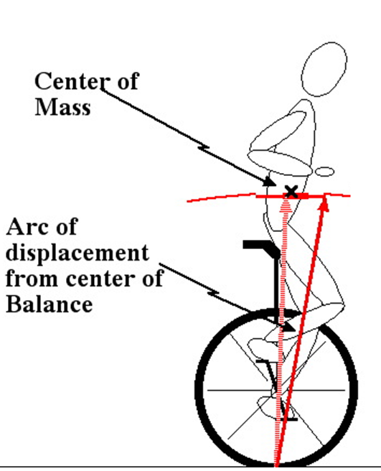
Working in Progress …
TSMC with Nonlinear Disturbance Observer applied to a Unicycle System
Apply TSMC to a Unicycle system taking in consideration anthropometric data.

Slide 19
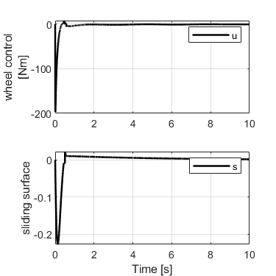
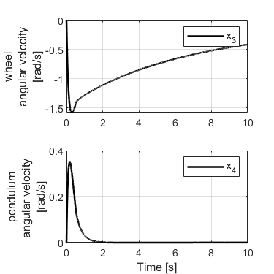
Working in Progress…
TSMC with Nonlinear Disturbance Observer applied to a Unicycle System

Slide 20
THANK YOU
Erivelton Gualter dos Santos

Slide 21

Extra References
V.SankaranarayananandA.D.Mahindrakar,“Controlofaclass of underactuated mechanical systems using sliding modes,” IEEE Transactionson Robotics,vol.25,no.2,pp.459–467,200
F. Grasser, A. D’Arrigo, S. Colombi, and A. C. Rufer, “JOE: a mobile, inverted pendulum,” IEEE Transactions on Industrial Electronics,vol.49,no.1,pp.107–114,2002
J. Huang, F. Ding, T. Fukuda, and T. Matsuno, “Modeling and velocity control for a novel narrow vehicle based on mobile wheeled inverted pendulum,” IEEE Transactions on Control SystemsTechnology,vol.21,no.5,pp.1607–1617,2013
J. Huang, F. Ding, T. Fukuda, and T. Matsuno, “Modeling and velocity control for a novel narrow vehicle based on mobile wheeled inverted pendulum,” IEEE Transactions on Control Systems Technology,vol.21,no.5,pp.1607–1617,2013
K.Pathak, J.Franch ,and S.K.Agrawal, “Velocity and position control of a wheeled inverted pendulum by partial feedback linearization,”IEEE Transactionson Robotics,vol.21,no.3,pp. 505–513,2005

